Slide 1
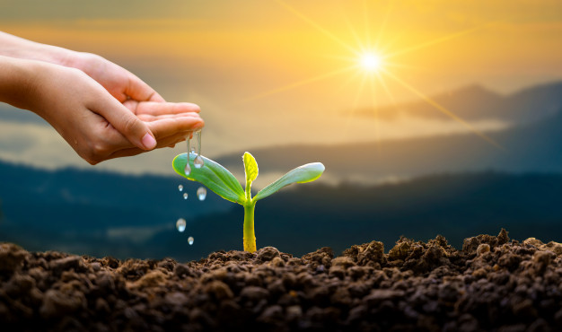
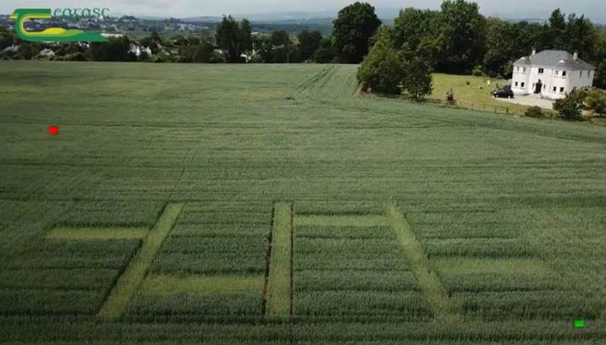
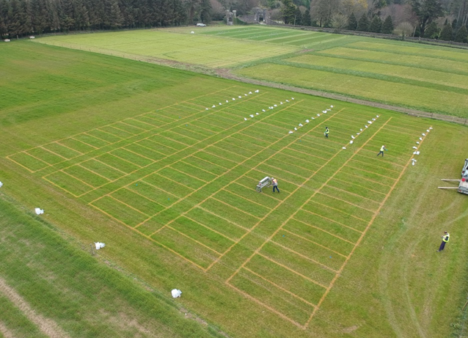
DEMONSTRATION
In 2019 yield for the bio-based fertiliser programmes were equal to conventional mineral fertiliser programmes.
Bio-based fertilisers show potential to efficiently deliver Phosphorus and other nutrients to crops.
Soil health effects and the benefits of recurring applications of bio-based fertilisers will be measured and demonstrated over the coming years of the experiment.
Stay in touch
National Task Forces
Biorefine Cluster
IRELAND - Teagasc Johnstown Castle, Wexford
@Bioref_cluster
@ForrestalPJ
@SM_Ashek
#Nutri2Cycle
www.nutri2cycle.eu
Nutri2Cycle on-farm arable site at Arklow (Spring Wheat Trial 2020)
Nutri2Cycle
Email: SM.Ashekuzzaman@teagac.ie
PROUD MEMBER
Transition towards a more carbon and nutrient efficient agriculture in Europe
of the
www.biorefine.eu
Nutri2Cycle Grassland agronomic trial at Teagasc, Wexford

Slide 2
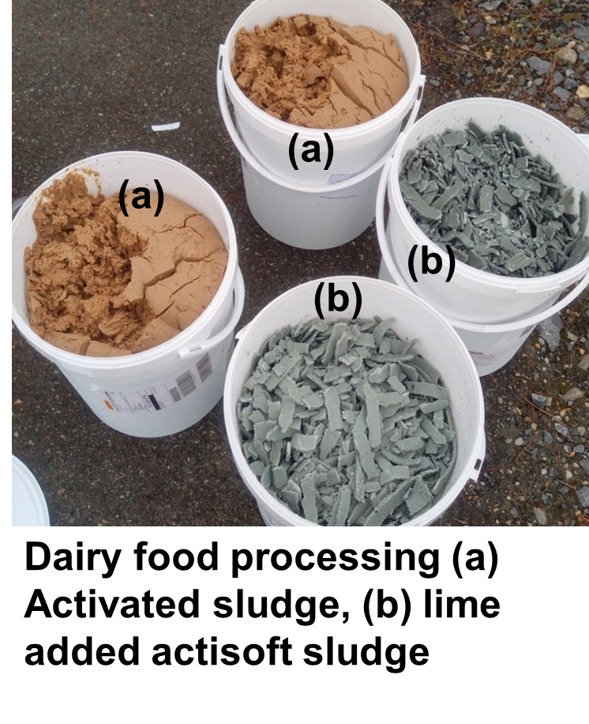
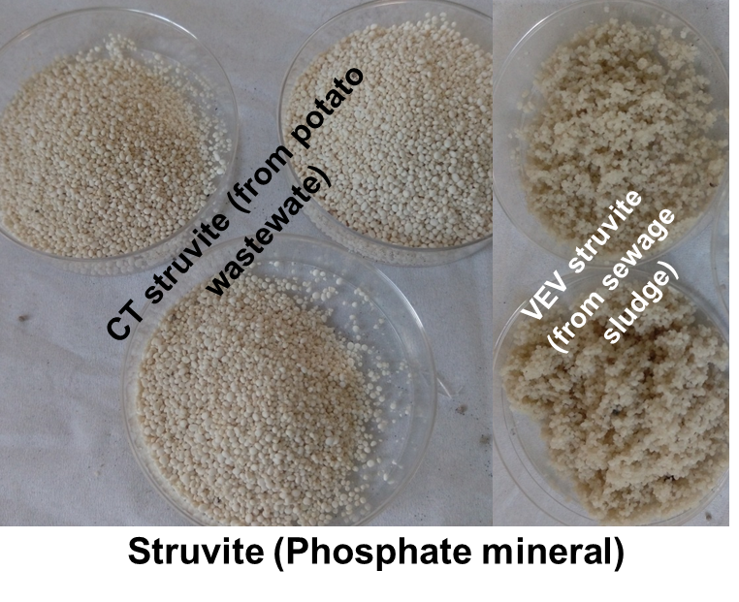
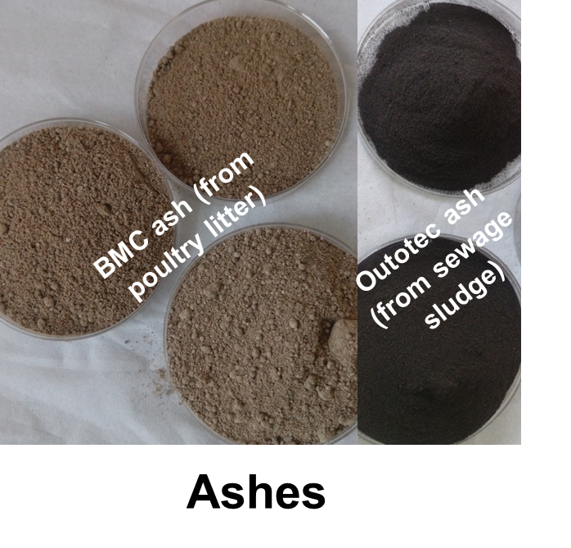
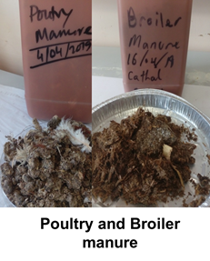
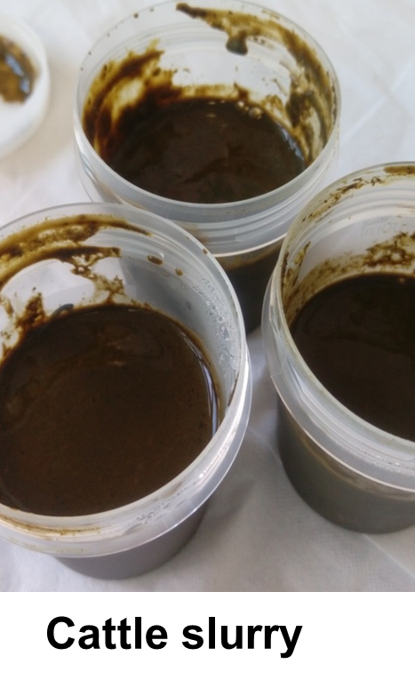
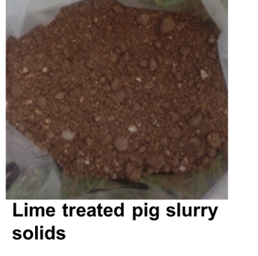
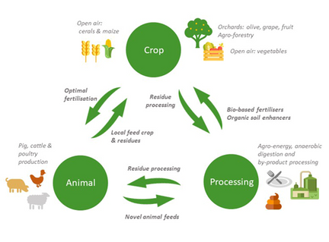
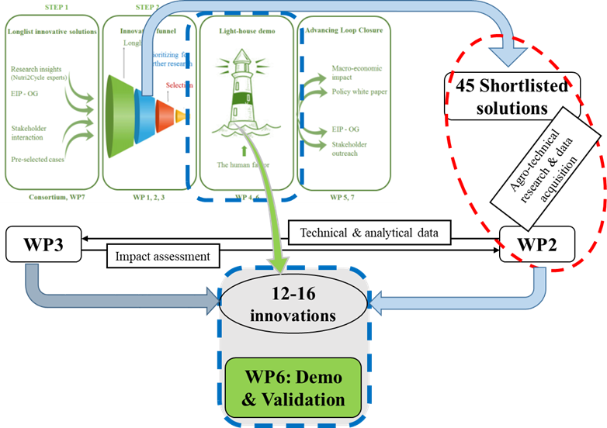
Nutri2Cycle mission & goals
The Nutri2Cycle, EU project is aimed at closing C-N-P loops by reconnecting nutrient & carbon flows between conventional agro-pillars through agro-processing.
About the project
The Nutri2Cycle will be running from 2018 to 2022.
European agriculture is still characterized by a high overall contribution to greenhouse gas emissions and inefficient recovery of carbon and re-use of major plant nutrients. The project will assess the current Nitrogen, Phosphorus and Carbon flows looking into existing management techniques in different farms across Europe & analysing their related environmental problems.
NATIONAL TASK FORCES
National Task Forces were set up in all Nutri2Cycle member states to enable the percolation of project results to local level in local language.
Bio-based recycling fertilisers
The project will:
Benchmark existing N-P-C flows
Propose & test innovative technologies at local level
Validate (prototype lighthouse demo’s)
Elaborate strategic scenario’s to identify the effect of these innovations at EU scale
In Ireland, Teagasc – The Agriculture and Food Development Authority, as one of the work package (WP) lead partners, is coordinating the Nutri2Cycle WP6 involving lighthouse demo investigations and their translation into practice.
Trial on RECYCLING C-N-P
In the frame of Nutri2Cycle project, agronomic trials using different agri-food processing waste resources as the source of bio-based recycling fertilisers are currently progressing in Teagasc.
The aim is to assess agronomic benefits (build soil C, N, P fertility) and to facilitate farmers’ understanding to use these options and to replace chemical fertilisers.
Agronomic trial plots were set up in two land management systems – I) grassland and II) arable farmland.
NUTRI2CYCLE brings together the extensive expertise of leading experts in the field of nutrient cycling from 19 organisations of 12 EU countries.

